Slide 1
BIN381 – Milestone 4
Presentation
GROUP 5
Jandre Neethling · 601304
Henri Claassen · 601720
Declin Vorkel · 601756

Slide 2

Introduction
Overview
The purpose of the project was to investigate socioeconomic development, household well-being and economic participation in South Africa. The main goal was to define a defensible analytics problem, select relevant data, engineer an analytical dataset, uncover patterns, build and evaluate suitable models, and communicate a decision support solution based on the 2024 South African survey dataset.
Our Project
For our project we decided our focus was on the relationship between digitalisation (access to the internet) and education and whether they act as complements, substitutes or independent of each other when it comes to employment. The reason our project focuses on this is because every year the National Treasury budgets for both education and digitalisation and our goal is to analyse the data given and try to justify the allocation of the budget. If it is proven that one has a greater effect than the other on employment, then it should be allocated a greater budget, if both combined have an effect on employment then both budgets should be planned and targeted together or if they have no effect on employment and should get their budgets reduced.

Slide 3



Crisp-DM: Business Understanding
OUR PROBLEM
High Unemployment, unequal access
Education is very important for getting a job, but job seeking now happens online. If half the country does not have online or digital access, is our country getting the full value out of what we spend on education?
THE STAKEHOLDER
National Treasury
The National treasury advises the government on how to allocate development funding so they need evidence on whether these two budgets affect each other and that is where we come in.
THE QUESTION
The effect on employment?
Does the interaction between home internet and education boost each other, replace each other or have no effect together with regards to education?

Slide 4



Crisp-DM: Data Understanding
We assumed that no dataset was clean. We checked each one independently for completeness, uniqueness, validity, consistency and structure. There were however problems we picked up on.
The most prevalent problems included the following:
4 of 11 Stats SA datasets selected
D01
D02
D03
D04
D05
D06
Household IDs were being rounded
D07
D08
D09
D10
D11
The Household IDs were being rounded during the import process due to them being of the double datatype and were 18 digits long, meaning instead of 20000 distinct households there was only 1 with the value: 1.60e17.
D01 Population: age, sex, province, survey weights
D02 Learning: education level and attendance
D03 Economic participation: employment and salary
D08 Connectivity: household internet and devices
Salary was mostly placeholder codes
74% of all of the salary values were “888888888” or “999999999”, which stood for “not applicable” and “non-response”, meaning that 74% (94% after cleaning) of the sample didn’t get paid or didn’t want to reveal their salary.
Left out:
D04 - D07, D09 and D10 are not needed
D11’s data comes from a separate survey
D11 could not be linked
D11 shares none of D01-D10’s household IDs, so we took employment information from D03 instead.

Slide 5
Crisp-DM: Data Preparation
1
Clean
2
Integrate
3
Transform
4
Engineer & Reduce
5
Split
We selected our 4 datasets and we cleaned by checking for duplicate values, treating outliers and much more.
Combining the Person ID and Household ID of all datasets to create a shared relationship
Scaling the data, Encoding it and grouping our data into, for example age groups.
We created 24 features, dropped several unimportant columns and filtered them according to age and if they work.
We dropped all leakage columns and created an 80/20 split by household with a fixed seed of 67.
FROM SURVEY FILES TO MODEL DATA
70,440
45,413
28,742
80 / 20
people in the cleaned survey files
of working age, 15 to 64
in the labour force: the model data
train / test split, by household

Slide 6




Crisp-DM: Modelling
Survey-weighted logistic regression
MAIN MODEL
VALIDATION DESIGN
Estimates the interaction as an odds ratio
For a fair comparison we tested the same 15 predictors. With logistic regression we also tested matric × home internet.
Regressions use survey weights and household clusters to represent RSA.
Five fold cross validation, grouped by household so performance isn’t inflated.
Thresholds tuned on training folds for balanced accuracy.
Income is modelled separately as exploratory (No salary for 96% of people)
Decision tree
Readable if-then rules and finds interactions itself
CHECK
Random forest
Flexible benchmark for predictive power
BENCHMARK
Demographics-only baseline
Age, sex, group and location: the bar to beat
BASELINE

Slide 7

Crisp-DM: Evaluation - Model Performance
SELECTED MODEL
Survey-weighted logistic regression
0.765
Test AUC
The demographics only baseline scores 0.727
0.693
Balanced accuracy at the tuned 0.639 threshold
What is the AUC (Area Under Curve) Score?
AUC is a performance metric used to measure how well a model separates two groups, in our case we check how good the model is at telling employed and unemployed people apart.
Brier score (How close the model’s predicted probabilities are to what actually happened).
The lower, the better
0.183
Why we don’t choose the top scorer?
The random forest is only 0.009 AUC ahead. Only the regression tests the interaction directly, uses the survey weights and stays explainable.

Slide 8
Crisp-DM: Evaluation - Key Findings
THE ANSWER FOR THE NATIONAL TREASURY
Education and home internet are complements, not substitutes
1.29
Interaction between matric and home internet odds ratio.
+6.3
more employed per 100 with home internet, among people with matric.
All four success criteria met
Significant, interpretable, AUC above 0.70 and the random forest finds the same pattern unprompted.
Income tells a different story
No significant interaction for salary, so it is reported separately as exploratory.
+1.8
per 100 among people without matric, which may be chance.

Slide 9
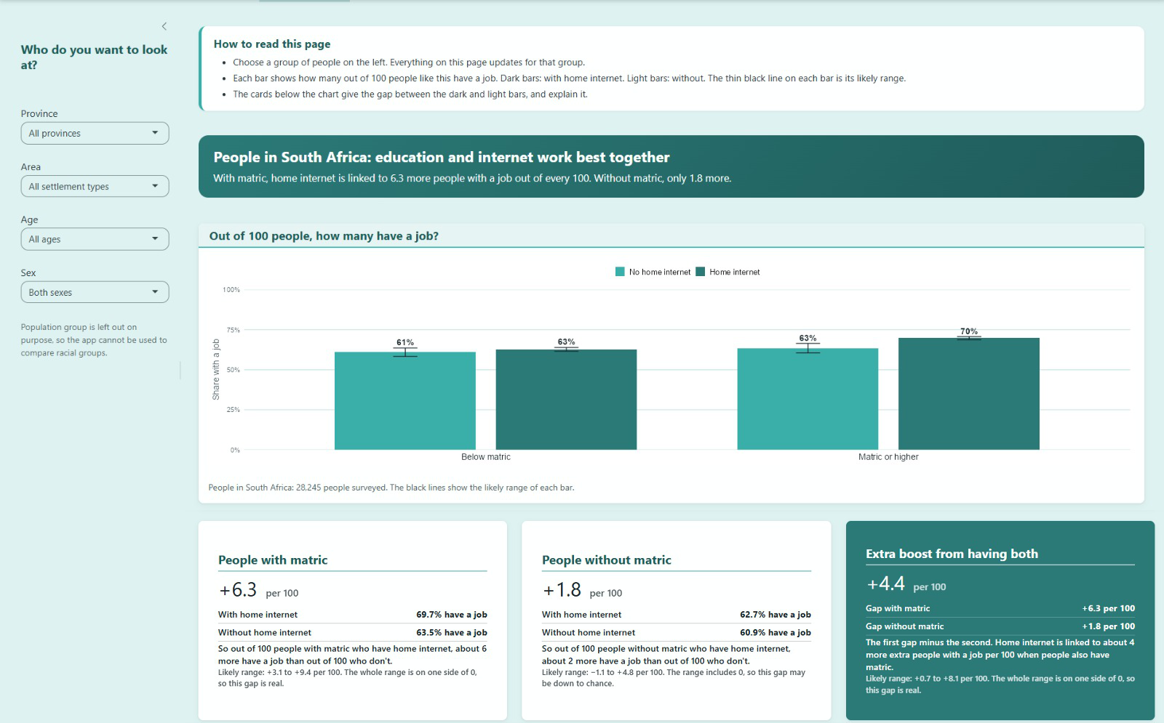

Crisp-DM: Deployment
LIVE DEMO - SHINY APP AND POWER BI
Power BI dashboard
Shows analysts where the pattern sits: employment by education, home internet, province and group.
R/Shiny app
Runs the selected model: group results with likely ranges, province scenarios and checks on new data.
Responsible by design
Group results only and no population group filter. Our uploads are monitored for accuracy, drift and fairness.

Slide 10
Recommendations and Limitations
1
Fund connectivity and education together
LIMITATIONS AND ETHICS
With matric, home internet goes with 6.3 more people employed per 10 and without matric it is only 1.8.
A single 2024 datasource can’t show the reasons why the analysed data appears as it does and might be biased as the only source of truth.
Accuracy differs across population groups and not across individuals (Race groups need to be created, otherwise the data is skewed due to the 71% black unemployment number).
We did not account for household wealth (D09) affecting home internet.
Income is exploratory with about 30% of salary variation explained.
2
Do not rely on internet access alone
For people without matric the gap is small and may be chance, so access needs education beside it.
3
Start where home internet is lowest
Allocate a larger budget to provinces with less overall internet access, which will lead to the largest gains.

